Slide 1


DBMS MINI PROJECT
FOOD TECH
ONLINE FOOD ORDERING SYSTEM
A Relational Database Management System — DBMS Mini Project
Group Members
Pingali Harshini Venkata Naga Deepika
Koduri Varshith
Nasyam Muhammad Abdul Lateef
Notes:
1

Slide 2








INTRODUCTION
FOOD-TECH DATABASE
INTRODUCTION
A database-driven online food ordering system designed to efficiently manage customers, restaurants, food items, orders, order details, and payments.
Project Overview
Core Purpose
The system stores and organizes food-ordering information in a relational database, allowing data to be easily stored, retrieved, and updated.
The main purpose is to maintain accurate and consistent data while connecting customers, restaurants, food items, orders, and payments through related tables.
Key Entities
Customer
Restaurant
Food Item
Orders
Order Detail
Payment
Notes:
2

Slide 3







SQL WORKFLOW
IMPLEMENTATION
SQL IMPLEMENTATION AND RESULTS
The database was implemented using MySQL and SQL commands including:
CREATE DATABASE
CREATE TABLE
UPDATE
SELECT
CREATE DATABASE online_food_ordering;
CREATE TABLE Customer (
customer_id INT PRIMARY KEY,
first_name VARCHAR(50)
);
UPDATE Orders SET restaurant_id = 6 WHERE order_id = 6;
SELECT * FROM Orders;
Retrieved and displayed stored data
Created the online_food_ordering database
Updated existing order records
GROUP BY
INSERT INTO
Defined all six tables with columns and constraints
SELECT restaurant_id, COUNT(*) AS total_orders
FROM Orders GROUP BY restaurant_id;
JOIN
INSERT INTO Customer
(first_name, last_name, email)
VALUES
('Rahul', 'Sharma', 'rahul.sharma@gmail.com');
SELECT c.first_name, o.order_id, o.total_amount
FROM Customer c JOIN Orders o
ON c.customer_id = o.customer_id;
ALTER TABLE
ALTER TABLE Food_Item DROP COLUMN quantity_available;
Analyzed and aggregated data by restaurant
Inserted sample records into tables
Modified table structures and constraints
Combined data from multiple related tables
SQL commands were used to create, modify, populate, retrieve and analyze data in the Online Food Ordering System database.
Notes:
3

Slide 4

DATABASE DESIGN
DATA FLOW
RELATIONSHIPS AND DATA FLOW
Database Entity Relationships:
Customer → Orders
Restaurant → Orders
Restaurant → Food_Item
Orders → Order_Detail
1:M customer_id
1:M restaurant_id
1:M restaurant_id
1:M order_id
Food_Item → Order_Detail
Orders → Payment
1:1 order_id
1:M food_id
Data Flow: A Customer places an Order with a Restaurant. Each Order contains multiple Order_Details, which reference Food_Items. Each Order is associated with one Payment record.
Notes:
4

Slide 5

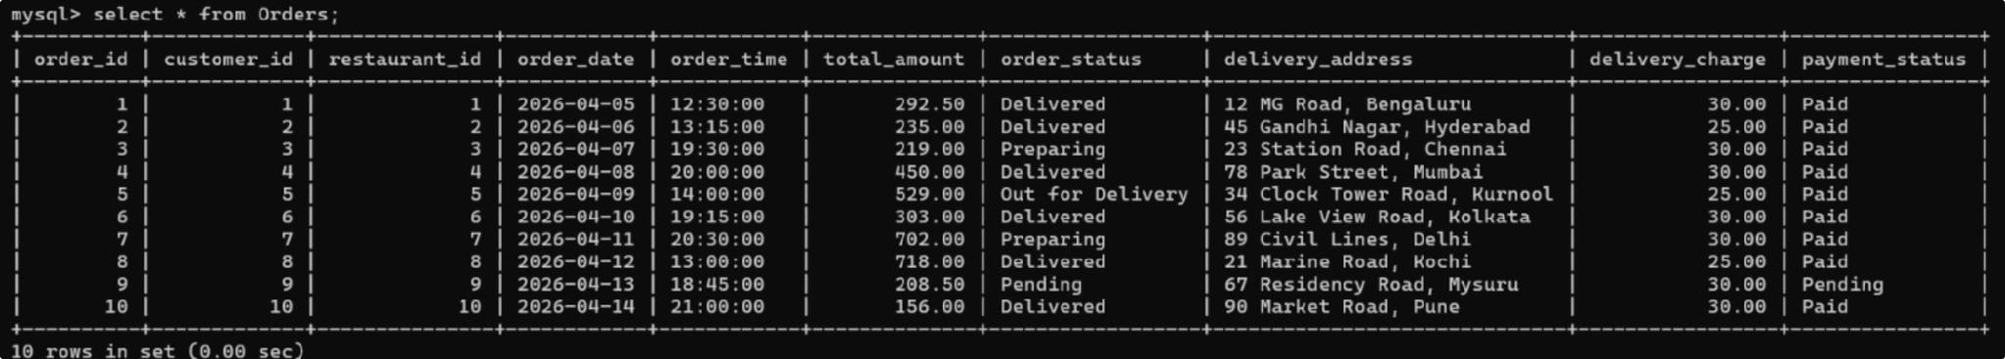
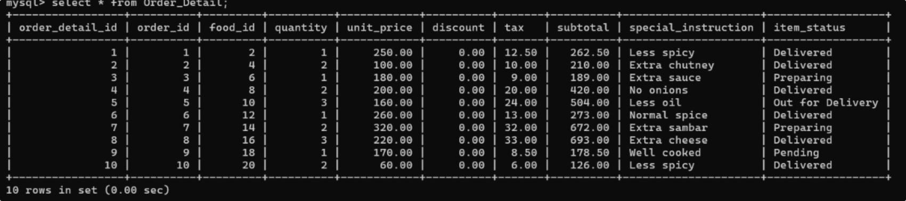
FOOD TECH
SCHEMA REFERENCE
ORDERS AND ORDER_DETAIL TABLES
Clean schema reference for the two core transaction tables and their key relationships.
Orders Table
Order_Detail Table
Key Relationships
Orders.customer_id references Customer.customer_id
Orders.restaurant_id references Restaurant.restaurant_id
Order_Detail.order_id references Orders.order_id
Order_Detail.food_id references Food_Item.food_id
Notes:
5

Slide 6
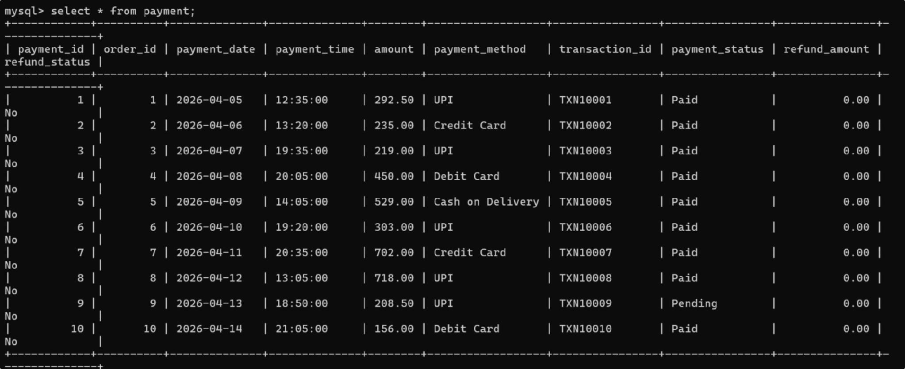
FOOD-TECH
DATABASE SCHEMA
PAYMENT TABLE
MySQL screenshot of the Payment table with sample records
payment_id | order_id | payment_date | payment_time | amount | payment_method | transaction_id | payment_status | refund_amount | refund_status
The Payment.order_id column is a Foreign Key that references Orders.order_id, establishing a one-to-one relationship between orders and payments.
Notes:
6

Slide 7

PROBLEM STATEMENT & OBJECTIVES
Challenges of Manual Management
Project Objectives
• Store customer information securely and efficiently
• Store restaurant information and manage multiple restaurants
• Manage food items and their details
• Manage orders and order details
• Manage payment information and transaction records
• Establish Primary Key–Foreign Key relationships
• Maintain data integrity and consistency
• Retrieve information efficiently using SQL queries
Data Redundancy
Data Inconsistency
Duplicate information stored across multiple locations leads to bloated, unmanageable records.
Conflicting or outdated information appears in different records, undermining reliability.
Difficulty Tracking Orders
Payment Management
Hard to monitor order status and history without a centralized system.
Complex payment tracking and reconciliation becomes error-prone manually.
Slow Data Retrieval
Time-consuming manual searches and lookups reduce operational efficiency.
Notes:
7

Slide 8








SCOPE OF THE PROJECT
Modern food-tech platform scope covering customer, restaurant, menu, order, payment, and reporting workflows.
Customer Management
Restaurant Management
Food Item Management
Order Management
Customer registration and profile management with secure data storage.
Food-item management with categories and pricing details.
Order management, tracking, and order-detail management with item-level information.
Restaurant information storage and multi-restaurant administration.
Payment Management
SQL Reporting
Payment management and transaction records for all completed orders.
Database relationships, constraints, and SQL-based data retrieval and reporting.
Notes:
8

Slide 9


TECHNOLOGIES USED
Technology Stack
Tools & Environment
MySQL
Microsoft Paint
Relational Database Management System — the core engine for storing and managing all project data.
Used for diagram visualization and ER diagram drawing.
MySQL Command Line
SQL
Primary interface for database implementation, testing, and query execution.
Structured Query Language used for all database operations including DDL, DML, and DQL.
All implementation was performed directly in the MySQL Command Line Client, ensuring authentic database interaction and real query output.
ER Diagram
Entity-Relationship modeling used to design and visualize the database schema before implementation.
Notes:
9

Slide 10

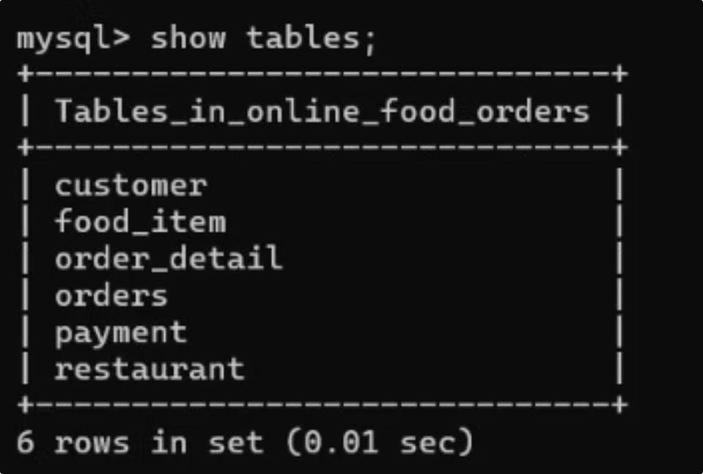


DATABASE OVERVIEW
MySQL — Database Tables Screenshot
Database Name
online_food_ordering
Six Core Tables
Customer
Restaurant
Food_Item
Orders
Order_Detail
Payment
Key Relationships
All tables are linked via Primary Key–Foreign Key constraints to enforce referential integrity throughout the system.
Notes:
10

Slide 11
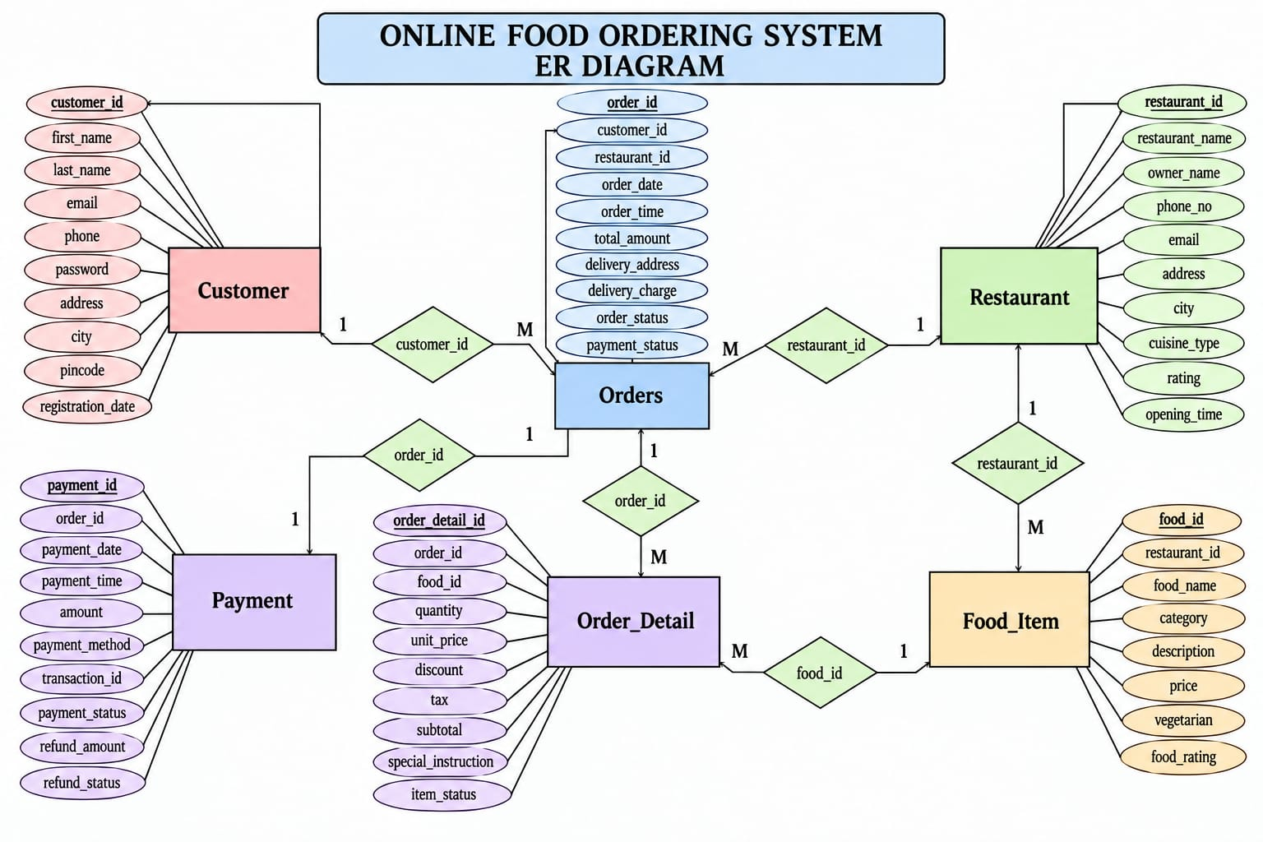
ER DIAGRAM
ER DIAGRAM
Figure: Entity-Relationship Diagram — Online Food Ordering System
Notes:
11

Slide 12
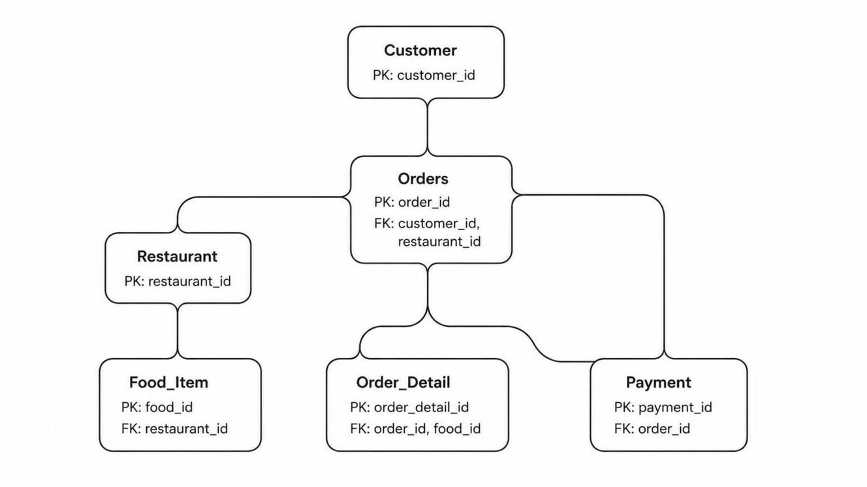
DATABASE SCHEMA
Customer
PK: customer_id
Restaurant
PK: restaurant_id
Food_Item
PK: food_id | FK: restaurant_id
Orders
PK: order_id | FK: customer_id, restaurant_id
Order_Detail
PK: order_detail_id | FK: order_id, food_id
Payment
PK: payment_id | FK: order_id
Notes:
12

Slide 13

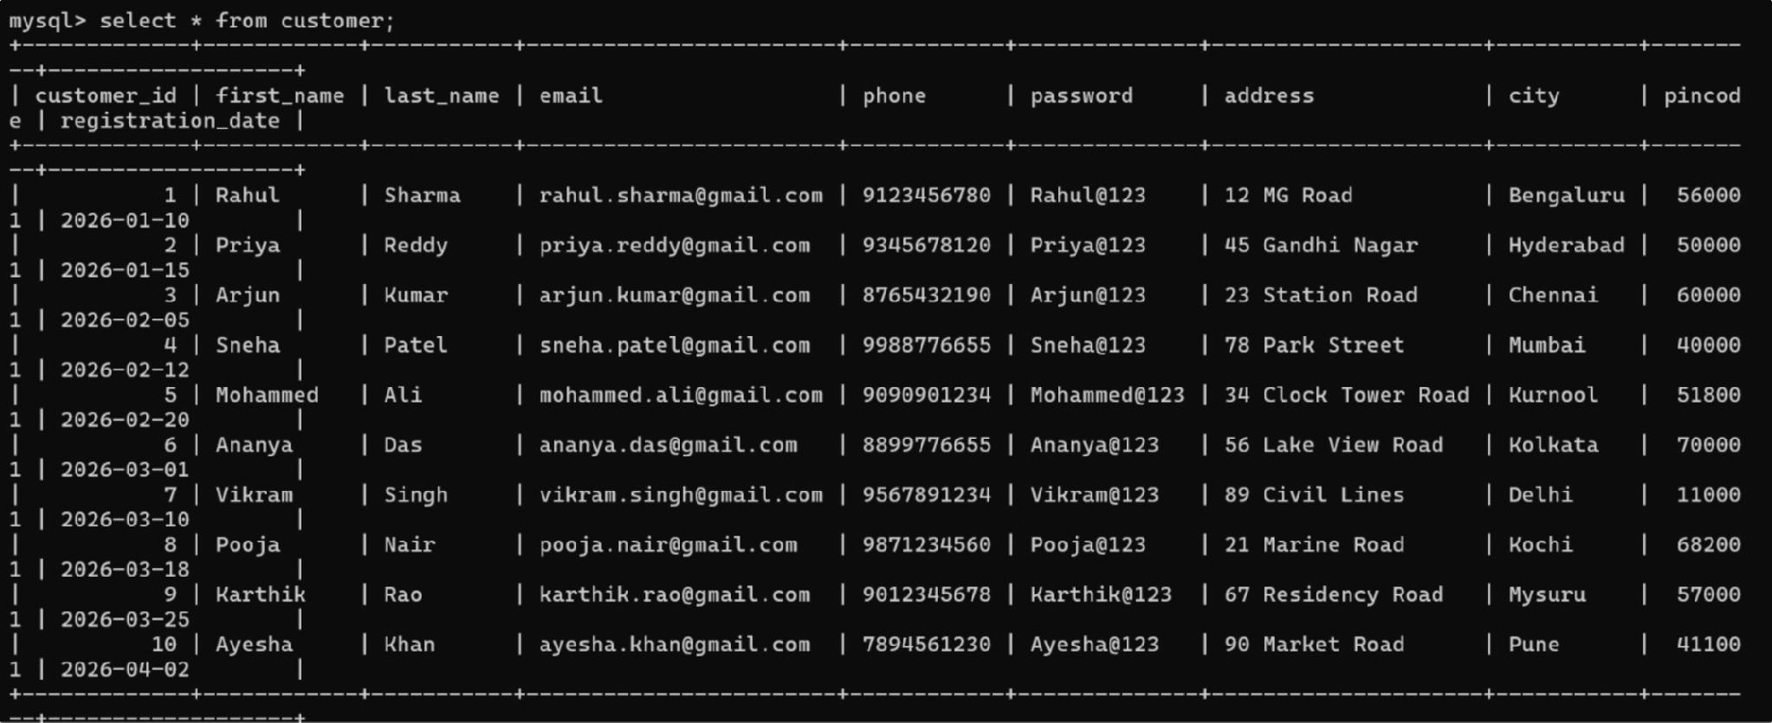
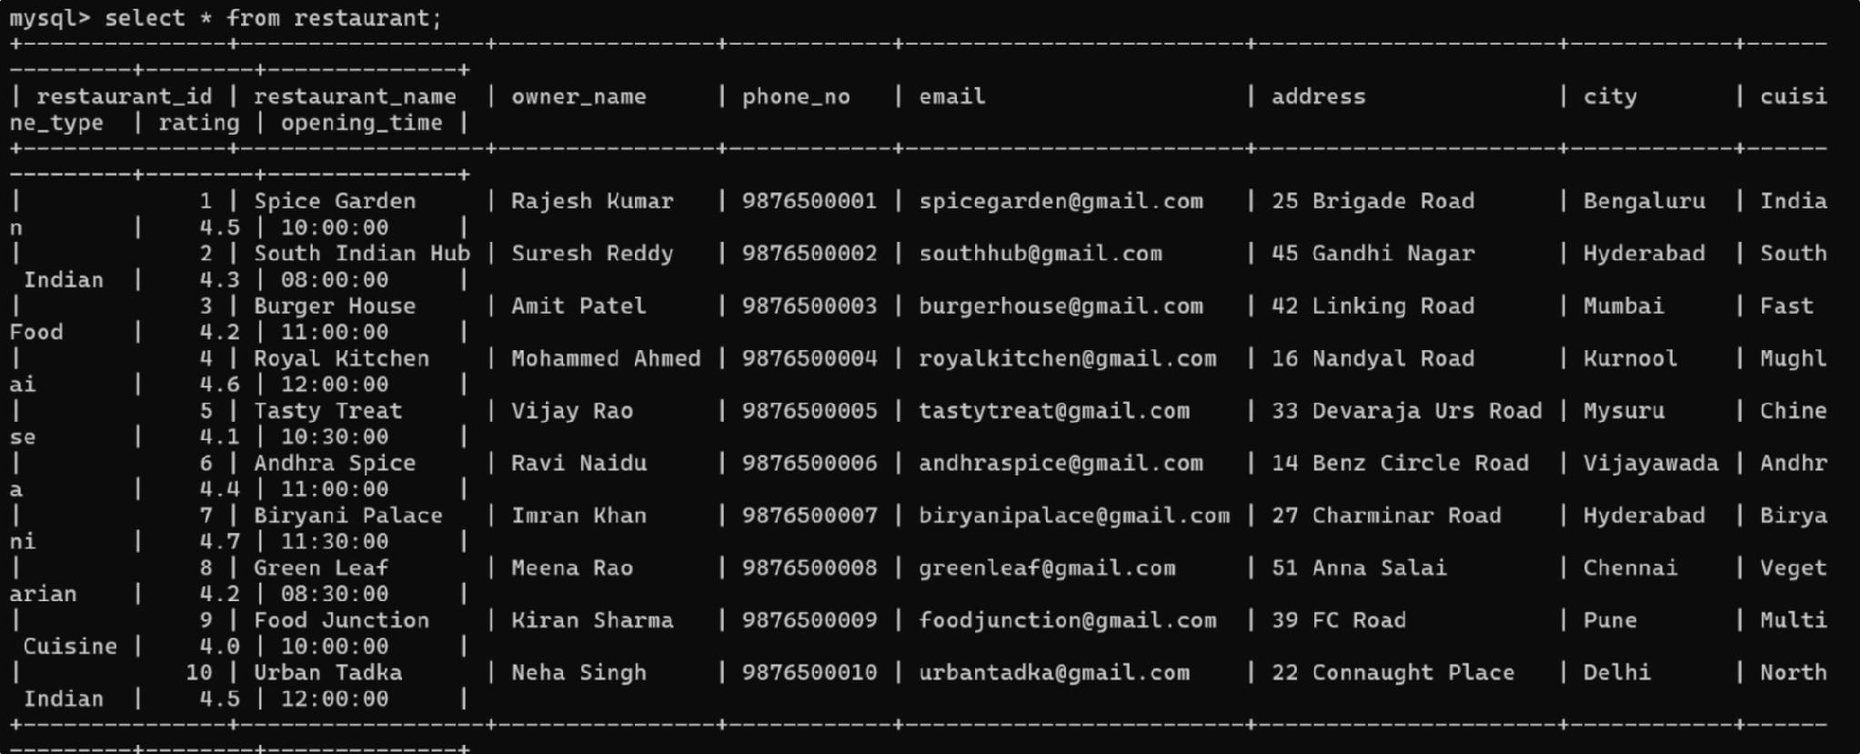
CUSTOMER & RESTAURANT TABLES
Premium modern overview of the two core tables in the food-tech database.
Customer Table
Restaurant Table
Columns: customer_id, first_name, last_name, email, phone, password, address, city, pincode, registration_date
Figure: Customer Table – Sample Records
Columns: restaurant_id, restaurant_name, owner_name, phone_no, email, address, city, cuisine_type, rating, opening_time
Figure: Restaurant Table – Sample Records
Notes:
13

Slide 14

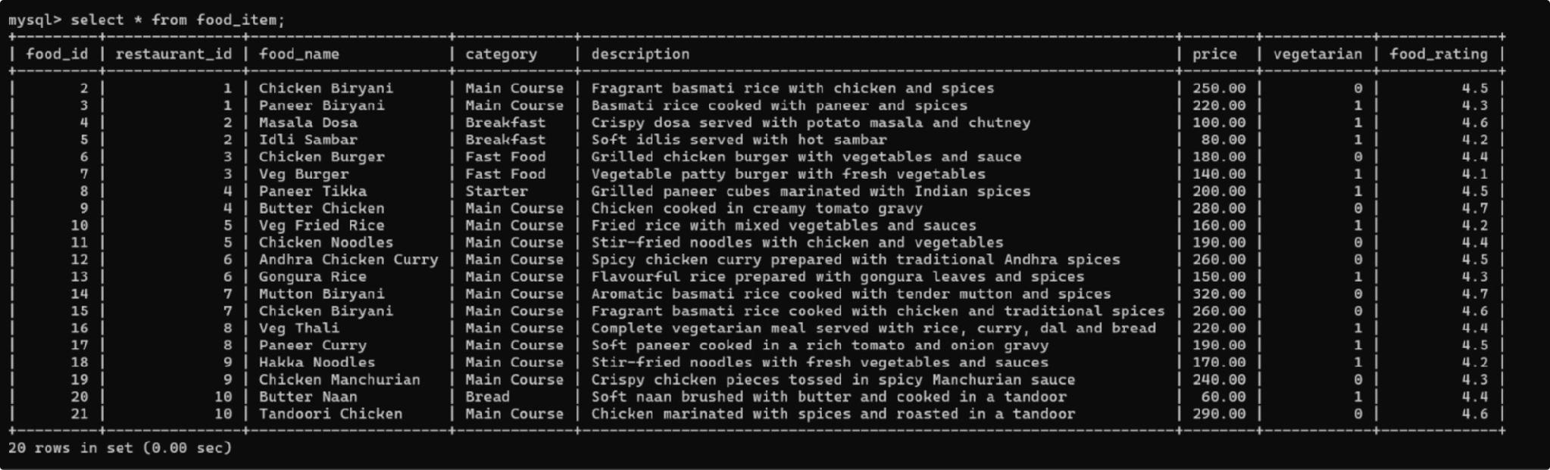
DATABASE SCHEMA
FOOD MANAGEMENT
FOOD_ITEM TABLE
Columns: food_id, restaurant_id, food_name, category, description, price, vegetarian, food_rating
The restaurant_id column is a Foreign Key that connects the Food_Item table to the Restaurant table, establishing a one-to-many relationship.
Figure: Food_Item Table – Sample Records
Notes:
14

Slide 15


CONCLUSION
Modern Food-Tech database project summary and learnings
PROJECT SUMMARY
LEARNING OUTCOMES
The Online Food Ordering System successfully demonstrates the design and implementation of a fully relational database using MySQL. The project covers all core aspects of a DBMS mini-project — from ER modeling to schema creation and data population.
ER Modeling
Translated real-world food ordering requirements into a structured entity-relationship diagram.
KEY ACHIEVEMENTS
Designed a normalized relational schema with six interconnected tables
Established Primary Key–Foreign Key relationships across all entities
Maintained referential integrity and data consistency throughout
Implemented and tested the database using MySQL Command Line
Schema Design
Applied normalization principles to eliminate redundancy and ensure data integrity.
SQL Implementation
Gained hands-on experience with DDL and DML operations in a real MySQL environment.
Relational Concepts
Reinforced understanding of PK–FK constraints, joins, and relational algebra in practice.
Notes:
15

